Slide 1
LESSON 30

Slide 2
Overview
of
Previous Lesson(s)

Slide 3
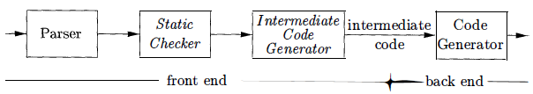
Over View
Front end analyzes a source program and creates an intermediate representation from which the back end generates target code.
A directed acyclic graph (DAG) for an expression identifies the common sub-expressions of the expression.

Slide 4
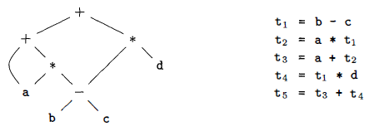
Over View..
Three-address code is a linearized representation of a syntax tree or a DAG in which explicit names correspond to the interior nodes of the graph.

Slide 5
Over View…
An address can be one of the following:
Name For convenience, we allow source-program names to appear as addresses in three-address code. In an implementation, a source name is replaced by a pointer to its symbol-table entry, where all information about the name is kept.
Constant In practice, a compiler must deal with many different types of constants and variables.
Compiler-generated temporary. It is useful, especially in optimizing compilers, to create a distinct name each time a temporary is needed.

Slide 6
Over View…
Types have structure, which is represented using type expressions
A type expression is either a basic type or is formed by applying an operator called a type constructor to a type expression.
Many type-checking rules have the form if two type expressions are equal then return a certain type else error
Potential ambiguities arise when names are given to type expressions and the names are then used in subsequent type expressions.

Slide 7
Over View…
When type expressions are represented by graphs, two types are structurally equivalent if and only if one of the following conditions is true:
They are the same basic type.
They are formed by applying the same constructor to structurally equivalent types.
One is a type name that denotes the other .

Slide 8
Over View…
Amount of storage that will be needed for the name at run time can be determined from the type of a name.
At compile time, we can use these amounts to assign each name a relative address.
The type and relative address are saved in the symbol-table entry for the name
Data of varying length, such as strings, or data whose size cannot be determined until run time, such as dynamic arrays, is handled by reserving a known fixed amount of storage for a pointer to the data

Slide 9
Over View…
Different methods for translation of expressions into three-address code.
Operations Within Expressions
Incremental Translation
Addressing Array Elements
Thanslation of Array References

Slide 10
Over View…
Operations Within Expressions
Ex. Using this syntax- directed definition,
assignment statement a = b + - c
is translated into the three-address code sequence
t₁ = minus c
t₂ = b + t₁
a = t₂

Slide 11
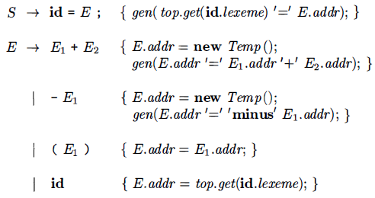
Over View…
Incremental Translation
Code attributes can be long strings, so they are usually generated incrementally.
In the incremental approach, gen not only constructs a three-address instruction, it appends the instruction to the sequence of instructions generated so far.
The sequence may either be retained in memory for further processing, or it may be output incrementally.

Slide 12
Contents
Type Checking
Rules for Type Checking
Type Conversions
Overloading of Functions and Operators
Type Inference and Polymorphic Functions
Control Flow
Boolean Expressions & Short-Circuit Code
Flow-of-Control Statements
Control-Flow Translation of Boolean Expressions
Boolean Values and Jumping Code

Slide 13
Type Checking
Type Checking includes several aspects.
The language comes with a type system, i.e., a set of rules saying what types can appear where.
The compiler assigns a type expression to parts of the source program.
The compiler checks that the type usage in the program conforms to the type system for the language.

Slide 14
Type Checking..
All type checking could be done at run time
The compiler generates code to do the checks.
Some languages have very weak typing; for example, variables can change their type during execution. Often these languages need run-time checks. Ex include lisp.
A sound type system guarantees that all checks can be performed prior to execution.
This does not mean that a given compiler will make all the necessary checks.

Slide 15
Rules for Type Checking
There are two forms of type checking.
Type synthesis where the types of parts are used to infer the type of the whole. Ex, integer + real = real.
Type inference is very slick. The type of a construct is determined from usage. This permits languages like ML to check types even though names need not be declared.
Checking statements is very similar. View the statement as a function having its components as arguments and returning void.

Slide 16
Type Conversions
A very strict type system would do no automatic conversion. Instead it would offer functions for the programmer to explicitly convert between selected types.
Then either the program has compatible types or is in error.
A more liberal approach in which the language permits certain implicit conversions that the compiler is to supply. This is called type coercion.
Explicit conversions supplied by the programmer are called casts.

Slide 17
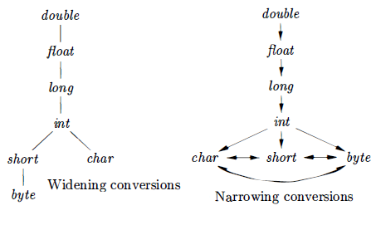
Type Conversions..
Type conversion rules vary from language to language.
The rules for Java distinguish between widening conversions which are intended to preserve information, and narrowing conversions which can lose information.

Slide 18
Overloading of Functions and Operators
An overloaded symbol has different meanings depending on its context.
Overloading is resolved when a unique meaning is determined for each occurrence of a name.
In a DAG representing a type expression, we assign an integer index called a value number, to each node then we construct a signature for a node consisting of its label and the value numbers of its children, in order from left to right.
The signature for a function consists of the function name and the types of its arguments

Slide 19
Overloading of Functions and Operators..
The assumption that we can resolve overloading based on the types of arguments is equivalent to saying that we can resolve overloading based on signatures.
It is not always possible to resolve overloading by looking only at the arguments of a function.
In Ada, instead of a single type, a sub expression standing alone may have a set of possible types for which the context must provide sufficient information to narrow the choice down to a single type

Slide 20
Type Inference and Polymorphic Functions
Type inference ensures that names are used consistently.
Type inference is useful for a language like ML, which is strongly typed, but does not require names to be declared before they are used.
The term "polymorphic" refers to any code fragment that can be executed with arguments of different types.
In parametric polymorphism, the polymorphism is characterized by parameters or type variables.

Slide 21
Type Inference and Polymorphic Functions..
This example is the ML program, which defines a function length.
fun length(x) = if null(x) then 0 else length(tl(x)) + 1;
The type of length can be described as for any type α length maps a list of elements of type α to an integer.
The keyword fun introduces a function definition, functions can be recursive.
The program fragment defines function length with one parameter x.

Slide 22
Type Inference and Polymorphic Functions…
The predefined function null tests whether a list is empty, and the predefined function tl (short for tail) returns the remainder of a list after the first element is removed.
The function length determines the length or number of elements of a list x.
All elements of a list must have the same type, but length can be applied to lists whose elements are of any one type.

Slide 23
Type Inference and Polymorphic Functions…
In the following expression, length is applied to two different types of lists.
length([" sun " , "mon" , " tue "]) + length([10, 9, 8, 7])
The list of strings has length 3 and the list of integers has length 4, so expression evaluates to 7.
Using the symbol V and the type constructor list, the type of length can be written as
Vα. list(α) → integer

Slide 24
Type Inference and Polymorphic Functions
The ∀ symbol is the universal quantifier, and the type variable to which it is applied is said to be bound by it.
Bound variables can be renamed at will, provided all occurrences of the variable are renamed.
Thus, this type expression is equivalent
∀β. list(β) → integer

Slide 25
Type Inference and Polymorphic Functions
A type expression with a ∀ symbol in it will be referred to informally as a "polymorphic type."
Each time a polymorphic function is applied, its bound type variables can denote a different type.
During type checking, at each use of a polymorphic type we replace the bound variables by fresh variables and remove the universal quantifiers.

Slide 26
Control Flow
The translation of statements such as if-else-statements and while-statements is tied to the translation of boolean expressions.
In programming languages, boolean expressions are often used to
Alter the flow of control Boolean expressions are used as conditional expressions in statements that alter the flow of control. The value of such boolean expressions is implicit in a position reached in a program. For example, in if (E) S , the expression E must be true if statement S is reached.

Slide 27
Control Flow..
Compute logical values A boolean expression can represent true or false as values. Such boolean expressions can be evaluated in analogy to arithmetic expressions using three-address instructions with logical operators.
The intended use of boolean expressions is determined by its syntactic context.
Ex, an expression following the keyword if is used to alter the flow of control, while an expression on the right side of an assignment is used to denote a logical value.

Slide 28
Boolean Expressions
Boolean expressions are composed of the boolean operators applied to elements that are boolean variables or relational expressions.
Relational expressions are of the form El reI E2 , where El and E2 are arithmetic expressions.
consider boolean expressions generated by the following grammar:
B → B ǁ B | B && B | !B | (B) | E reI E | true | false
We use the attribute reI.op to indicate which of the six comparison operators <, <=, =, ! =, >, or >= is represented by reI.

Slide 29
Boolean Expressions..
Given the expression B₁ ǁ B₂ if we determine that B₁ is true, then we can conclude that the entire expression is true without having to evaluate B₂
Given B₁&&B₂ if B₁ is false, then the entire expression is false.
The semantic definition of the programming language determines whether all parts of a boolean expression must be evaluated.
If the language definition permits portions of a boolean expression to go unevaluated, then the compiler can optimize the evaluation of boolean expressions by computing only enough of an expression to determine its value.

Slide 30
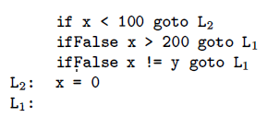
Short Circuit Code
In short-circuit (or jumping) code, the boolean operators &&, ǁ and ! translate into jumps.
The operators themselves do not appear in the code, instead, the value of a boolean expression is represented by a position in the code sequence.

Slide 31
Flow of Control Statement
The translation of boolean expressions into three-address code in the context of statements such as those generated by the following grammar.
S → if ( B ) S₁
S → if ( B ) S₁ else S₂
S → while ( B ) S₁
In these productions, nonterminal B represents a boolean expression and nonterminal S represents a statement .

Slide 32
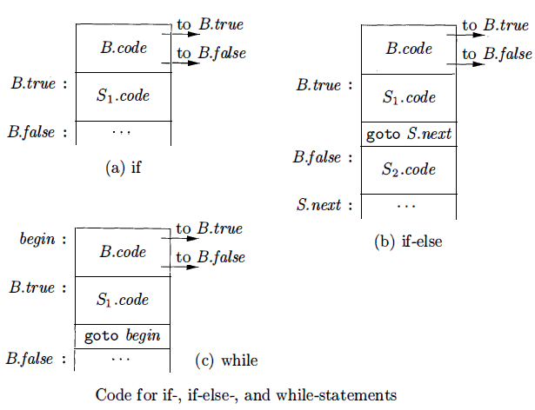
Flow of Control Statement..

Slide 33
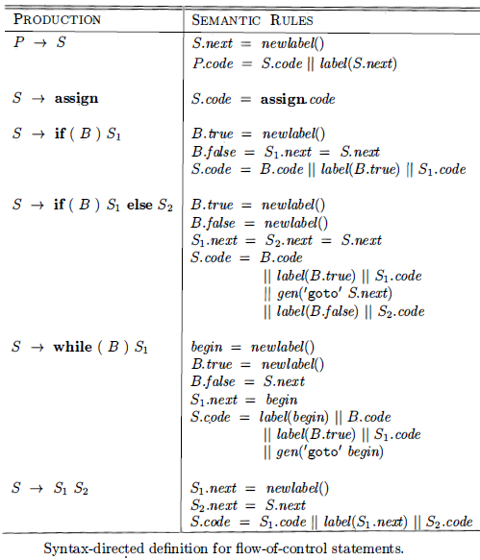
Flow of Control Statement..

Slide 34

of COURSE

Slide 35
What we can build
Using
Intermediate Code Generation

Slide 36
Intermediate Representation
We can combine the pieces learned in Intermediate code generation section to build a simple compiler front end.
The front end can be built incrementally:
Pick an intermediate representation An intermediate representation is typically a combination of a graphical notation and three-address code.
As in syntax trees, a node in a graphical notation represents a construct, the children of a node represent its sub constructs.
Three address code takes its name from instructions of the form x = y op Z with at most one operator per instruction.
There are additional instructions for control flow .

Slide 37
Translate Expressions
Translate expressions
Expressions with built-up operations can be unwound into a sequence of individual operations by attaching actions to each production of the form E → E₁ op E₂
The action either creates a node for E with the nodes for E₁ and E₂ as children or
It generates a three-address instruction that applies op to the addresses for E₁ and E₂ and puts the result into a new temporary name, which becomes the address for E.

Slide 38
Check Types
Check types
The type of an expression E₁ op E₂ is determined by the operator op and the types of E₁ and E₂
A coercion is an implicit type conversion, such as from integer to float.
Intermediate code contains explicit type conversions to ensure an exact match between operand types and the types expected by an operator.

Slide 39
Declarations
Use a symbol table to implement declarations
A declaration specifies the type of a name.
The width of a type is the amount of storage needed for a name with that type.
Using widths, the relative address of a name at run time can be computed as an offset from the start of a data area.
The type and relative address of a name are put into the symbol table due to a declaration, so the translator can subsequently get them when the name appears in an expression.

Slide 40
Flatten Arrays
Flatten arrays
For quick access, array elements are stored in consecutive locations.
Arrays of arrays are flattened so they can be treated as a one dimensional array of individual elements.
The type of an array is used to calculate the address of an array element relative to the base of the array.
Generate jumping code for boolean expressions
In short-circuit or jumping code, the value of a boolean expression is implicit in the position reached in the code.

Slide 41
Boolean Values & Jumping Code
Jumping code is useful because a boolean expression B is typically used for control flow, as in if (B) S.
Boolean values can be computed by jumping to t = true or t = false, as appropriate, where t is a temporary name.
Using labels for jumps a boolean expression can be translated by inheriting labels corresponding to its true and false exits.
The constants true and false translate into a jump to the true and false exits, respectively .

Slide 42
Control Flow
Implement statements using control flow
Statements can be translated by inheriting a label next, where next marks the first instruction after the code for this statement .
The conditional S → if (B) S₁ can be translated by attaching a new label marking the beginning of the code for S₁ and passing the new label and S.next for the true and false exits, respectively, of B.

Slide 43
Implement Records
Implement records
Field names in a record or class can be treated as a sequence of declarations.
A record type encodes the types and relative addresses of the fields.
A symbol table object can be used for this purpose .

Slide 44
Thank You

